Slide 1
Why I Believe
IN GOD
(part 2)
“But sanctify the Lord God in your hearts, and always be ready to give a defense to everyone who asks you a reason for the hope that is in you, with meekness and fear” (1 Pet. 3:15)

Slide 2
Belief In God
Briefly noted from part 1:
We may develop faith from the apparent inspiration qualities of the Bible; if the Bible is the word of God, then God exists (Rom. 10:17; 2 Tim. 3:16, 17)
10 reasons why the Bible is the word of God
We may develop faith from investigating the life, death and resurrection of Jesus Christ (1 Pet. 1:20, 21)
Added the cosmological evidence for God (Ps. 19:1)
Whatever begins to exist has a cause
The universe began to exist
The universe has a cause
Universe calls for a super-mind and Jehovah fits that description
Today we add: complexity of life
Notes:
Psalm 19:1, “The heavens declare the glory of God; And the firmament shows His handiwork” (Psalm 19:1)

Slide 3
2. Design: Complexity in “Life”
Can life exist without a LIFE-GIVER?
Must the life-giver be living?
Could the information required for life, arise from lifeless matter?
“Nor is He worshiped with men’s hands, as though He needed anything, since He gives to all life, breath, and all things” (Acts 17:25)
1) Whatever Begins to Exist Has a Cause
2) Life Began To Exist
3) Life Has a Cause
Notes:
The reality and complexity of life screams there is a Creator.
Danny Falkner mentioned the chances of the reality of life coming into existences in the previous quote. The fact of life, its complexity and design is another reason I believe in God.
Everyone agrees that life began to exist. No one believes that life existed eternally in the universe. Yet, if life began to exist, then life has a cause. What is the more rational and reasonable choice? 1) Life began to exist from lifeless matter? An idea that can never be proven or observed. Or…Life began to exist out of lifeless matter from the special working of a living God? Must the life-giver be alive? With the amount of information that is needed to produce and sustain life, could such information exist within non-living matter to build living matter?

Slide 4
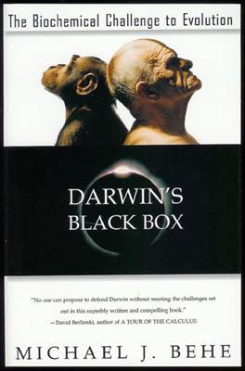
“I will praise You, for I am fearfully and wonderfully made; Marvelous are Your works, And that my soul knows very well” (Ps. 139:14)
Life Demands More Than Matter:
“Now it’s the turn of the fundamental science of life, modern biochemistry, to disturb. The simplicity that was once expected to be the foundation of life has proven to be a phantom; instead, systems of horrendous, irreducible complexity inhabit the cell. The resulting realization that life was designed by an intelligence is a shock to us in the twentieth century who have gotten used to thinking of life as the result of simple natural laws. But other centuries have had their shocks, and there is no reason to suppose that we should escape them.”
Behe, M. J., 1996. Darwin’s Black Box, (pp. 252, 253). New York, NY: The Free Press
Notes:
David long ago spoke by inspiration of the awe of life (Ps. 139:14). Michael Behe’s work in the field of biochemistry has been very forceful and disrupting to the atheistic community. Frank Sherwin made this observation, “In 1996 biochemist Michael Behe published a blockbuster entitled Darwin's Black Box. The crux of this fascinating book is that life—seen specifically in the single cell (i.e., Darwin's "black box")—is enormously intricate, having what Behe calls ‘irreducible complexity.’ He discusses, for example, the biochemistry of vision and blood clotting—showing a sophisticated cascade of biochemical events—each dependent on the previous reaction” (http://www.icr.org/article/egg-chicken-conundrum).
In addition Mr. Behe argues from the analogy of a mousetrap, that all components must be present for the trap to work. If only one component is gone, broken or missing, then the trap fails to be a trap and such is how microscopic engines within the cell work.

Slide 5
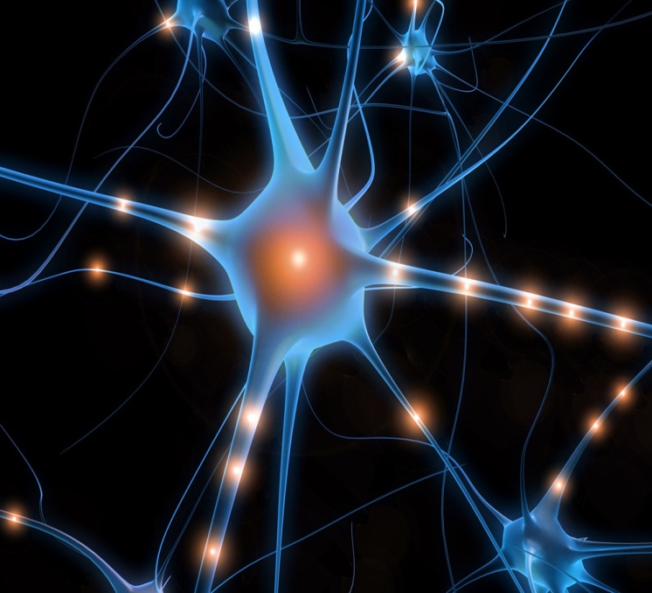
“I will praise You, for I am fearfully and wonderfully made; Marvelous are Your works, And that my soul knows very well” (Ps. 139:14)
“Our minds can’t comprehend the precision of some of them [balancing of fundamental laws and parameters of physics and the initial conditions of the universe, sjw]. The result is a universe that has just the right conditions to sustain life. The coincidences are simply too amazing to have been the result of happenstance—as Paul Davies said, ‘the impression of design is overwhelming’” (Robin Collins, PhD, interviewed by Lee Strobel, Case For A Creator, p.130)
Notes:
When all the conditions for life come into the equation, one expressed that the probability of these parameters coming into existence would be like one shooting a bullet at a 1 inch target 20 billion light years away (http://hettingern.people.cofc.edu/Philosophy_of_Religion/Collins_Scientific_Argument_for_Existence_of_God.htm)

Slide 6
The Facts For Life
Some Basic Necessities For Life:
Liquid Water
Energy
Suitable environment
The elements, information and mechanism for metabolism and reproduction
Abundant water
No energy = no life
Dense enough atmosphere, gravity
Life must replicate
~mechanism for reproduction must exist
~life cannot exist without already having the mechanism fully developed
~also requires the information/code/instruction to be fully present!
Notes:
The amazing thing is that the simple needs for life to exist all exist here on earth and have not been discovered to exist anywhere else.
A SUITABLE ENVIRONMENT for conditions to flourish (if you all the above exist without an abundance of water, or without a dense atmosphere to protect against solar ultraviolet radiation, or too low of gravity, then you don’t have life.
FOR LIFE TO EXIST, IT HAS TO REPRODUCE and for it to reproduce the mechanism for such has to exist and so what I am saying is that life needs water, but more than water. It involves more than mere ingredients, but also requires the way the ingredients are organized. Say you discover iron on Mars, does that mean there was one upon a time skyscrapers that decorated its horizon? Does it even mean that skyscrapers could be produced there? Of course not!
This begs the question, why or how did the universe by chance create a habitat that is hospitable for the parameters for not just life, but complex life to exist? No where else has this been discovered but earth. Why would we think the possibility of creating life here would have been any different than anywhere else if the universe exploded by mere chance. Rather, it makes more sense to believe life is here on earth because God, a life generating super-mind, first fashioned earth as a place where life could flourish.

Slide 7
John 1:1-4
1 In the beginning was the Word, and the Word was with God, and the Word was God.
2 He was in the beginning with God.
3 All things were made through Him, and without Him nothing was made that was made.
4 In Him was life, and the life was the light of men.
Notes:
One of the ingredients of Jesus and God for that matter is life. “He was the source of life…” (GWV). As creator of life, Jesus is also the light of men. From his life we find life and light. J. W. McGarvey wrote, “The life of Jesus is the light of men, because from that life we get our intellect and understanding, and because that life formed and governs the creation around us by which we become enlightened as to the existence and power of God (#Ro 1:18-21 Ac 14:16,17)” (The Fourfold Gospel, p. 2).

Slide 8
DNA FACTS
Referred to as the blue print of life
Found in all living things
Our entire DNA sequence is called a genome.
Our entire DNA sequence would fill 200 1,000-page New York City telephone directories.
DNA is so compact that a one-square-inch chip of DNA could encode the information in over 7 billion Bibles.¹
If unwound and tied together, the strands of DNA in one cell would stretch almost six feet but would be only 50 trillionths of an inch wide.
If you unwrap all the DNA you have in all your cells, you could reach the moon 6000 times!
You could reach the Sun 600 times
It would take a person typing 60 words per minute, eight hours a day, around 50 years to type the human genome. ²
(deoxyribonucleic acid)

Slide 9
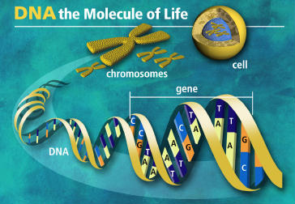
Are We Fearfully and Wonderfully Made?
Nucleus of Cell contains DNA
DNA is the CODE to our Genetic Makeup
Compared to a computer program
Did Microsoft Windows have a designer?
Notes:
DNA d(eoxyribo)n(ucleic) a(cid)

Slide 10
The Complexity of Life Required Intelligent Input!
CONCLUSION:

Slide 11
Acts 14:15-17
15 and saying, "Men, why are you doing these things? We also are men with the same nature as you, and preach to you that you should turn from these useless things to the living God, who made the heaven, the earth, the sea, and all things that are in them,
16 "who in bygone generations allowed all nations to walk in their own ways.
17 "Nevertheless He did not leave Himself without witness, in that He did good, gave us rain from heaven and fruitful seasons, filling our hearts with food and gladness."
Notes:
We preach on lessons like this to prod men to not only further equip believers with other informational sources for creation and for God, but also to prod unbelievers to turn from useless things to the living God. Life cries for a life-giver. In this life we always find life coming from life. But life could not have always existed on earth for eternity. It must have had a point of origin. It must have had a creation and hence a Creator. The Bible tells us that God is that creator and that we need to turn to Him.
Evolution is a “useless thing.” It is built on faulty premises and is without observation. It is not only bad logic, but bad science. It has become an idol for people today even as the men at Lystra worshiped false gods.

Slide 12
Acts 14:15-17
15 and saying, "Men, why are you doing these things? We also are men with the same nature as you, and preach to you that you should turn from these useless things to the living God, who made the heaven, the earth, the sea, and all things that are in them,
16 "who in bygone generations allowed all nations to walk in their own ways.
17 "Nevertheless He did not leave Himself without witness, in that He did good, gave us rain from heaven and fruitful seasons, filling our hearts with food and gladness."
Notes:
One of the charges laid against creationists is the presence of evil. That if God was good and real, that He would or could not allow this much evil to exist. First of all, who are we to question the ways of God? Second, Paul answers that charge with the reality of free-will (v. 16). God created us with free-will and hence men are free to do evil or good. You are free to turn to God or to reject Him today.

Slide 13
“In Him was life, and the life was the light of men” (Jn. 1:4)
Saving Man
Sustaining Man
Creation of Man
Christ
Raising Man
John 5:28, 29
John 5:24-27
Acts 17:28
Psalm 100:3
John 1:4
“in Him was life”
Notes:
John 11:25. As we showed Jesus previously, in Jesus is life (Jn. 1:4). That life animated non-living material when God created Adam from which all humans came (Ps. 100:3; Acts 17:26). That life animates and sustains us today so that we live and move and have our very being (Acts 17:28; Elihu in Job 33:4; Dan. 5:23). That life can spiritually animate us today (Jn. 5:24-27). Also, that life in Christ can reanimate the dead. One day all the dead will rise again (Jn. 5:28, 29).

Slide 14
THE PLAN TO SAVE
YOUR LIFE
Hear the Word of God---Rom. 10:17
Believing ---Jn. 11:25
Repenting Of Your Sins---Acts 2:38
Confess That Christ Is The Son of God--- Rom. 10:10; Acts 8:37
Be Baptized Into Christ---Gal. 3:26-29
Be Faithful Until Death---Rev. 2:10; I Cor. 15:58

